Slide 1

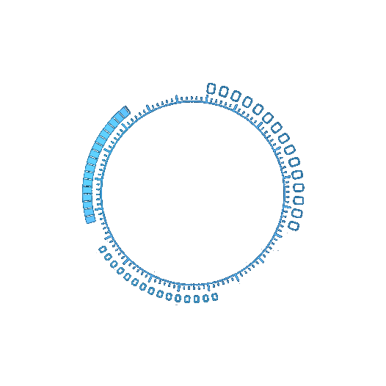

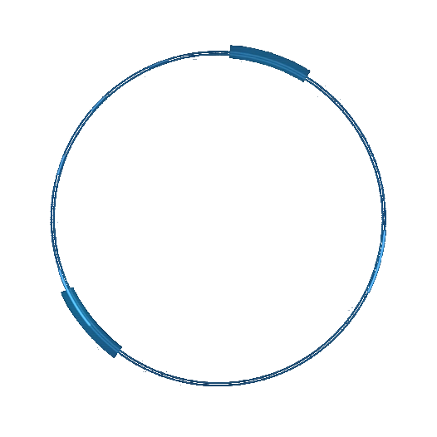
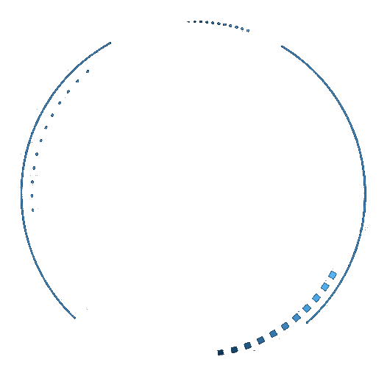
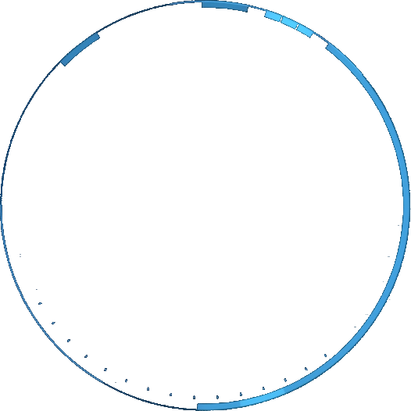

Performance Evaluator of Computational Blimps
ECE 209 Course Presentation
Team members:
Hongyi Li, Zhao Lei, Yifei Chen, Zeyu Wang, Zhaoliang Zheng
E-mails:
hongyil6@g.ucla.edu
zlei@g.ucla.edu
cyf@g.ucla.edu
zeyuwang@ucla.edu
zhz03@g.ucla.edu

Slide 2
01
Background
Related work
Introduction
03
Restoring force
Propulsion
Aerodynamics
Kinematics &
Dynamics
05
Future
work
Contents
02
Design
parameter Space
Evaluation
system overview
04
Simulation

Slide 3
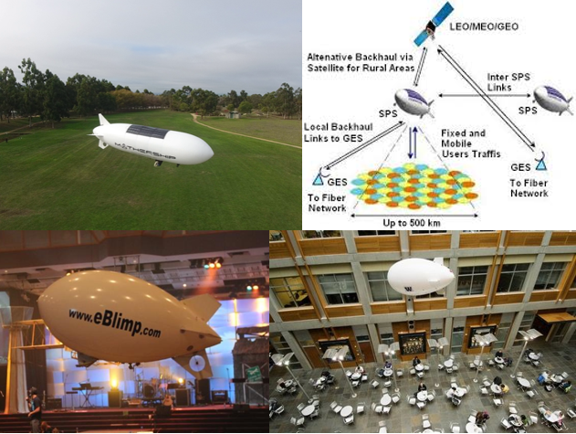

Airship out-door application
Airship in-door application
[1] dronelife.com
[2] eblimp.com
[3] “Development of Airships Stratospheric Platform Systems”
[4] University of Washington
01
Background
Background

Slide 4
Related work
What is the knowledge gap ???
Zufferey et al., “Flying over the reality gap: From simulated to real indoor airships”
Burri et al.“Design and control of a spherical omnidirectional blimp”
Blimp designs
control
Wang et al., “Altitude control for an indoor blimp robot”
Hiroaki et al.,“Model predictive control of an autonomous blimp with input and output constraints”
Wang, “Development of a blimp robot for indoor operation”, Ph.D. thesis 2020
Qiuyang Tao et al. “Parameter Identification of Blimp Dynamics through Swinging Motion”
modeling of airships

Slide 5

Our system explores the design parameters space of indoor airships with different configurations.
1
Introduction
We design a performance evaluation system that could characterize the performance of different shape and different configuration of different airships.
2

Slide 6
Design parameter space
Inputs
Blimp parameters
Geometry parameters
Component parameters
Fin surface / thrust
Force arms
Surface area
Blimp volume
Different shape
Motor/fin position
Total weight
Env parameters
Drag Coefficient
Helium density
Air density
temperature
Outputs
Max linear velocity
Time to reach max
Max angular velocity
attitude

Slide 7
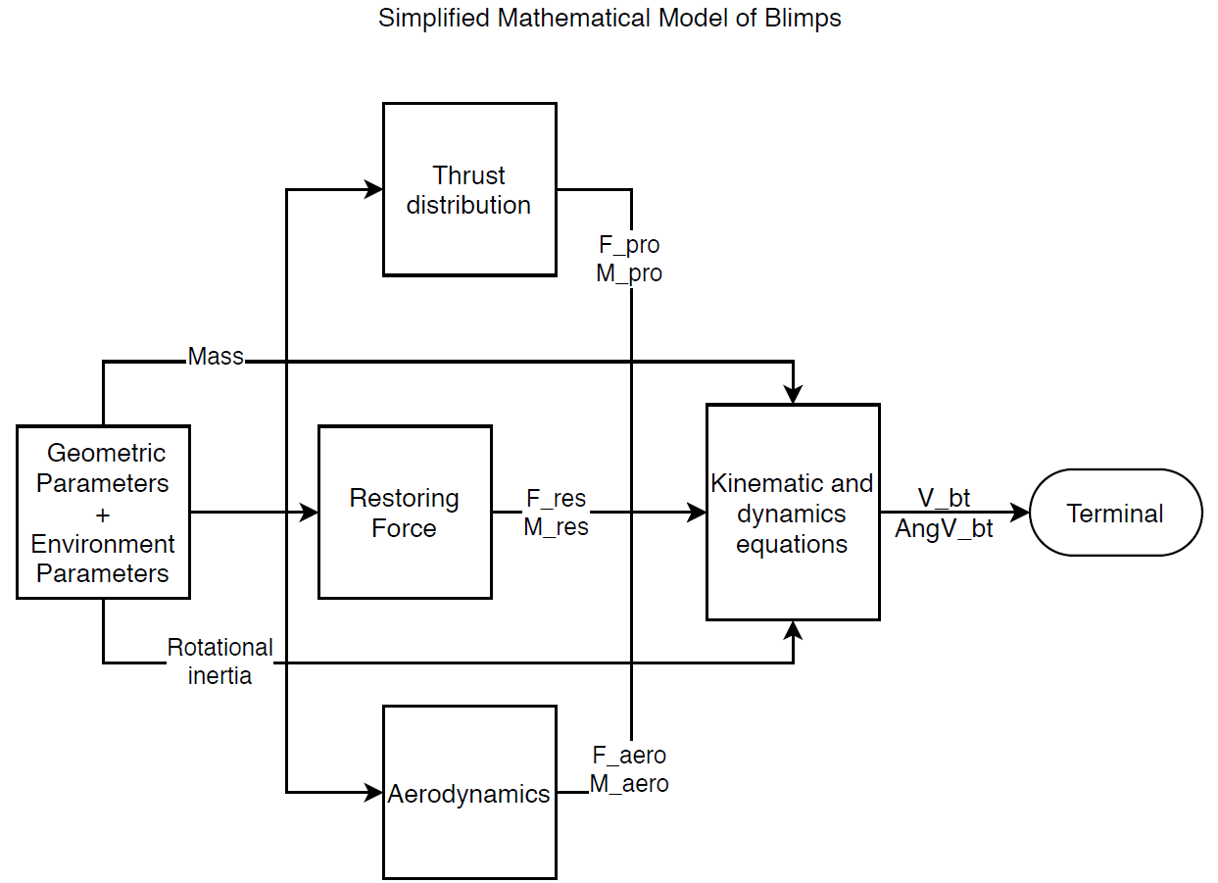
Evaluation system overview

Slide 8
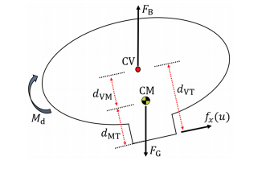

Restoring force: Buoyancy + Gravity
Density of air
Volume of blimp
Arm of buoyancy on x, y and z axis
Inputs
$$F_{B}=ρ_{air}V_{envelop}g=\left(m_{envelop}+m_{helium}\right)g+\left(m_{gondola}+m_{eletronic}+m_{ballast}\right)g$$
Outputs
Buoyancy force
Moments of buoyancy force
Tao, Q., Cha, J., Hou, M., & Zhang, F. (2018). Parameter Identification of Blimp Dynamics through Swinging Motion. Parameter Identification of Blimp Dynamics through Swinging Motion.

Slide 9
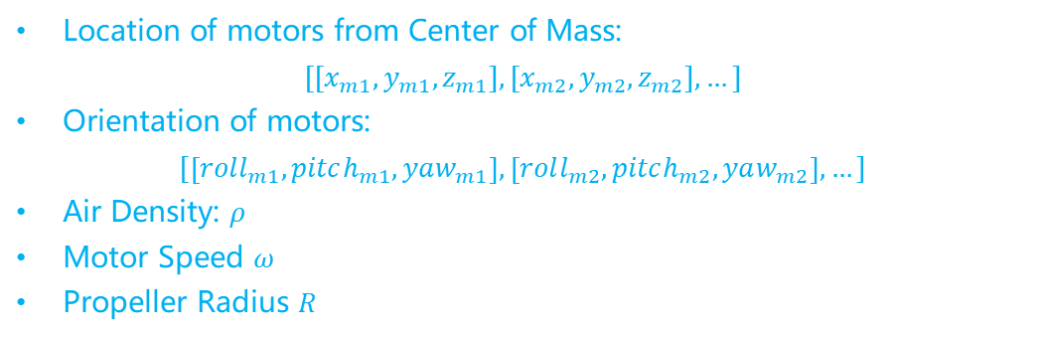
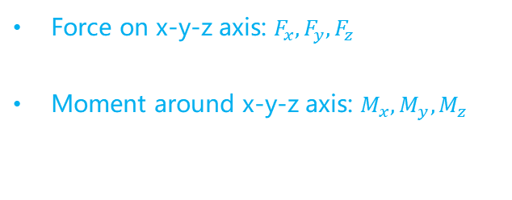
Propulsion
Location of motors from Center of Mass:
$$[[x_{m1},y_{m1},z_{m1}],[x_{m2},y_{m2},z_{m2}],…]$$
Orientation of motors:
$$[\left[roll_{m1},pitch_{m1},yaw_{m1}\right],\left[roll_{m2},pitch_{m2},yaw_{m2}\right],…]$$
Air Density: 𝜌
Motor Speed 𝜔
Propeller Radius 𝑅
Inputs
Outputs
Force on x-y-z axis: $F_{x}, F_{y}, F_{z}$
Moment around x-y-z axis: $M_{x}, M_{y}, M_{z}$
M. Battipede/ M. Lando,^ and P. Gili^ MATHEMATICAL MODELLING OF AN INNOVATIVE UNMANNED AIRSHIP FOR ITS CONTROL LAW DESIGN

Slide 10


Propulsion
Thrust: 𝑇= 𝜏𝜌𝜔^2 𝑅^4
𝜌 is the air density
𝜔 is the angular rate of the propellers
𝑅 is the radius
Assume:
𝜌 is 1.29Kg/m³
𝜔 is 40000RPM
𝑅 is 60 mm
Then we get 𝑇 = 1.07 N
$F_{x}=Pr∑{\operatorname{Pr}{Jx} \vec{T} }=∑|\vec{T}|cosφ$ ($φ$ is the angle between axis x and vector $\vec{T}$)
$F_{y}=Pr∑{\operatorname{Pr}{Jx} \vec{T} }=∑|\vec{T}|cosα$ ($α$ is the angle between axis x and vector $\vec{T}$)
$F_{z}=Pr∑{\operatorname{Pr}{Jx} \vec{T} }=∑|\vec{T}|cosβ$ ($β$ is the angle between axis x and vector $\vec{T}$)
$\vec{M}= \vec{F} \vec{l}= \left[\begin{matrix}0 & Fz & −Fy \\ −Fz & 0 & Fx \\ Fy & Fx & 0\end{matrix}\right]\left[\begin{matrix}lx \\ ly \\ lz\end{matrix}\right]$
$\vec{l}$ represents the position vector of each propeller with respect to center of mass
M. Battipede/ M. Lando,^ and P. Gili^ MATHEMATICAL MODELLING OF AN INNOVATIVE UNMANNED AIRSHIP FOR ITS CONTROL LAW DESIGN

Slide 11
Aerodynamic Force
Force Source
Differential pressure resistance
Friction resistance
Lift force
Aerodynamic coefficients (Analysis in x,y,z planes)
ρ: Air density
v: Speed of body relative to the fluid (Decomposition in x,y,z planes)
V: volume of body, it is common practice to express the reference area in terms of
ꭤ,ꞵ: Angle of attack; angle of sideslip
Drag Model Inputs

Slide 12
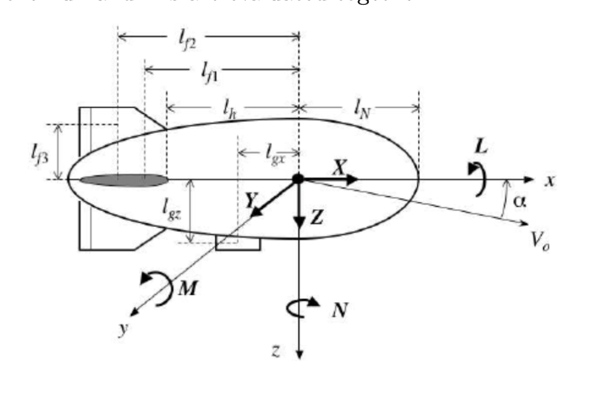

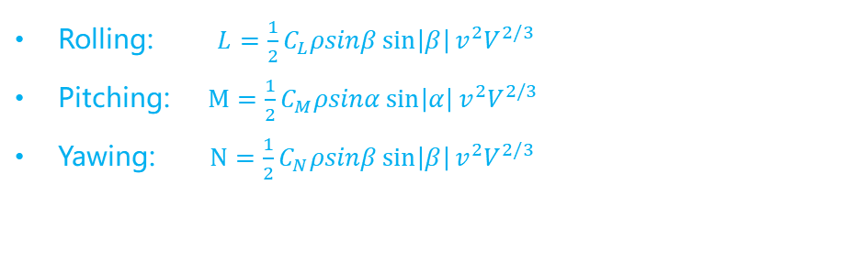
Aerodynamic Force & Moments
$F_{x}= \frac{1}{2}C_{Dx}ρ{\left(vcosαcosβ\right)}^{2}V^{2/3}$
$F_{y}= \frac{1}{2}C_{Dy}ρ{ρv}^{2}sinβsin⁡|β|V^{2/3}$
$F_{z}=\frac{1}{2}C_{Dz}ρ{ρv}^{2}sinαsin⁡|α|V^{2/3}$
Net Force
Rolling: $L=\frac{1}{2}C_{L}ρsinβ\sin\left|β\right|v^{2}V^{2/3}$
Pitching: $M=\frac{1}{2}C_{M}ρsinα\sin\left|α\right|v^{2}V^{2/3}$
Yawing: $N=\frac{1}{2}C_{N}ρsinβ\sin\left|β\right|v^{2}V^{2/3}$
Moment
J. B. Mueller, M. A. Paluszek, and Y. Zhao, “Development of an Aerodynamic Model and Control Law Design for a High Altitude
Airship,” Proceeding of the AIAA 3rd Unmanned Unlimited Technical Conference, Workshop, and Exhibit, Chicago, IL, September 2004.

Slide 13

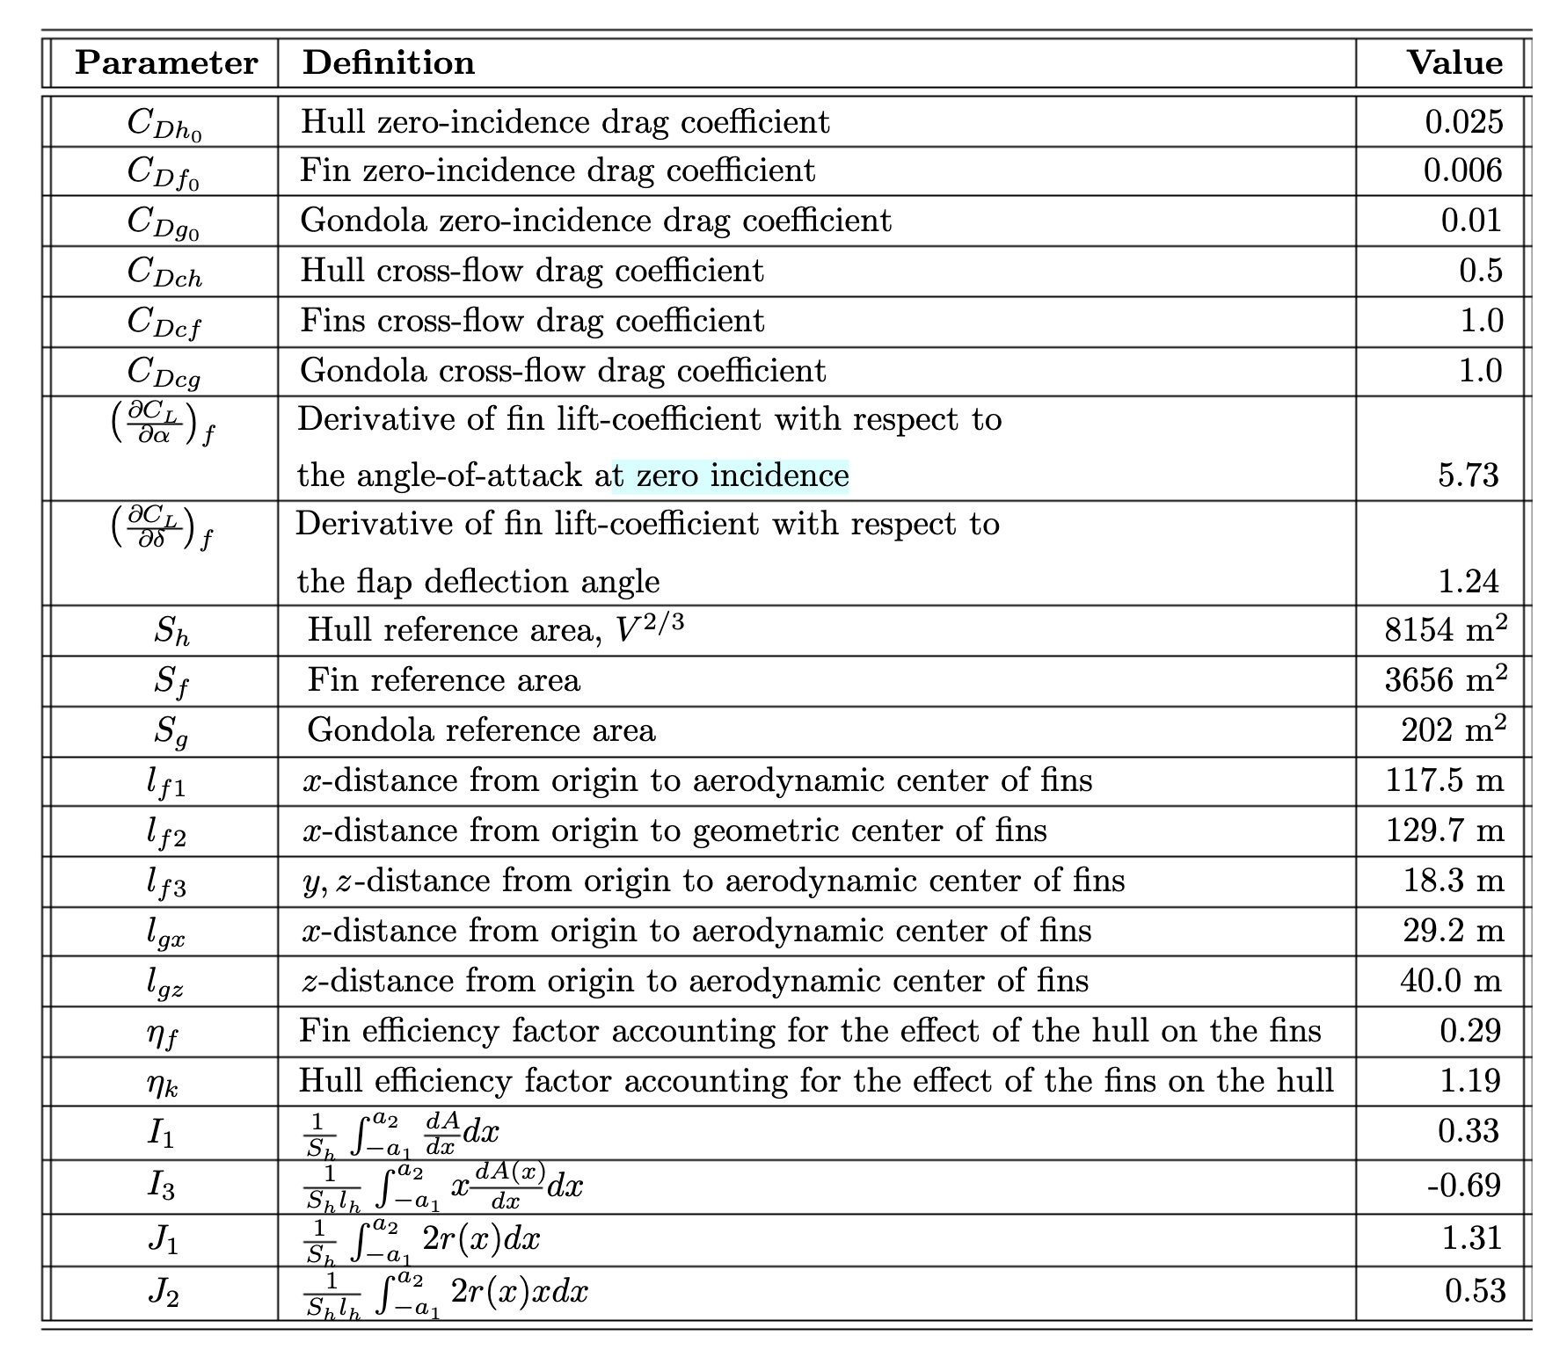
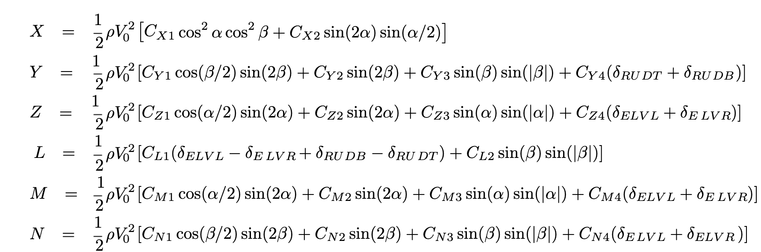
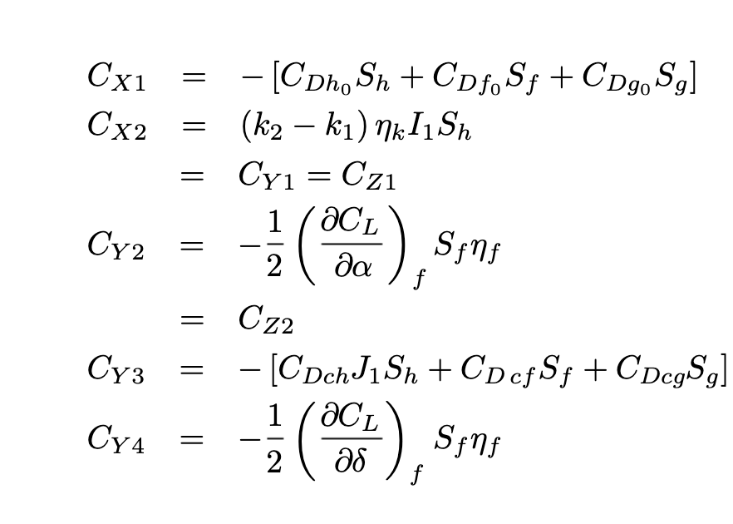
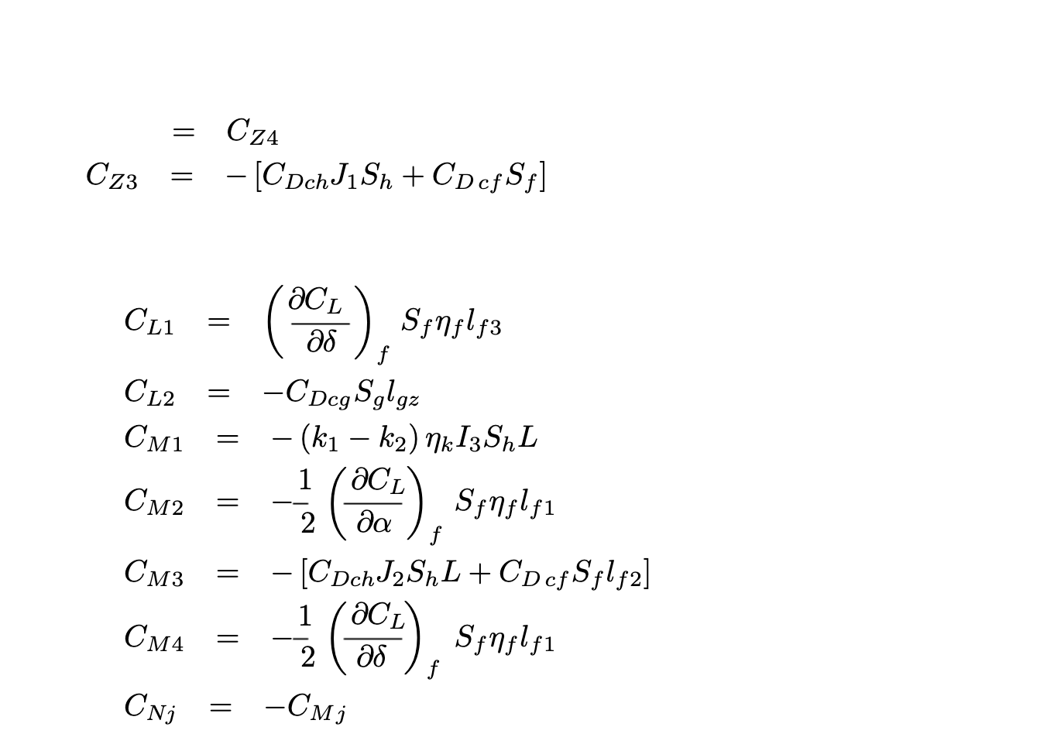
Aerodynamic Force & Moments
J. B. Mueller, M. A. Paluszek, and Y. Zhao, “Development of an Aerodynamic Model and Control Law Design for a High Altitude
Airship,” Proceeding of the AIAA 3rd Unmanned Unlimited Technical Conference, Workshop, and Exhibit, Chicago, IL, September 2004.

Slide 14
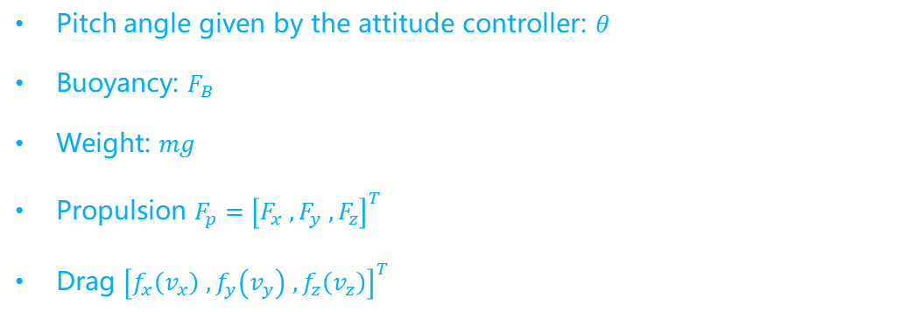

Kinematics and Dynamics – Input, output
Pitch angle given by the attitude controller: $θ$
Buoyancy: $F_{B}$
Weight: $mg$
Propulsion $F_{p}={\left[F_{x} , F_{y} , F_{z}\right]}^{T}$
Drag ${\left[f_{x}\left(v_{x}\right) ,f_{y}\left(v_{y}\right) ,f_{z}\left(v_{z}\right)\right]}^{T}$
Inputs
Maximum velocity : $v_{max}$
Time to max speed: $T_{max}$
Outputs
M. Battipede/ M. Lando,^ and P. Gili^ MATHEMATICAL MODELLING OF AN INNOVATIVE UNMANNED AIRSHIP FOR ITS CONTROL LAW DESIGN

Slide 15
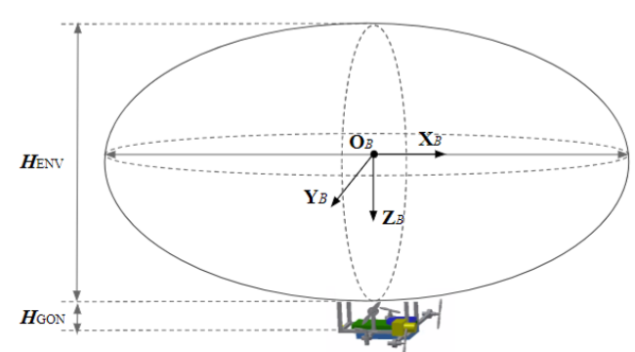
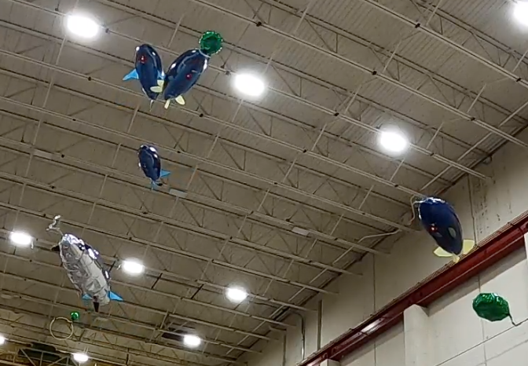
Dynamics - Assumption
Frame: North-East-Down
Attitude: roll = 0
Wind: calm -> airspeed = ground speed
Body frame axes
Blimps in the competition
Q. Tao, J. Cha, M. Hou and F. Zhang, "Parameter Identification of Blimp Dynamics through Swinging Motion," 2018 15th International Conference on Control, Automation, Robotics and Vision (ICARCV), Singapore, 2018, pp. 1186-1191, doi: 10.1109/ICARCV.2018.8581376.

Slide 16
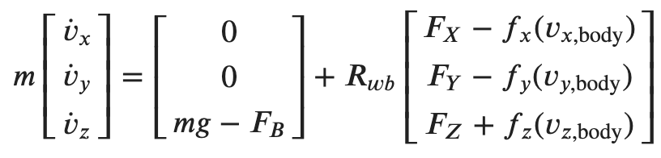

Dynamics - Equation
Linear
Angular
N. Michael, D. Mellinger, Q. Lindsey and V. Kumar, "The GRASP Multiple Micro-UAV Testbed," in IEEE Robotics & Automation Magazine, vol. 17, no. 3, pp. 56-65, Sept. 2010, doi: 10.1109/MRA.2010.937855.

Slide 17
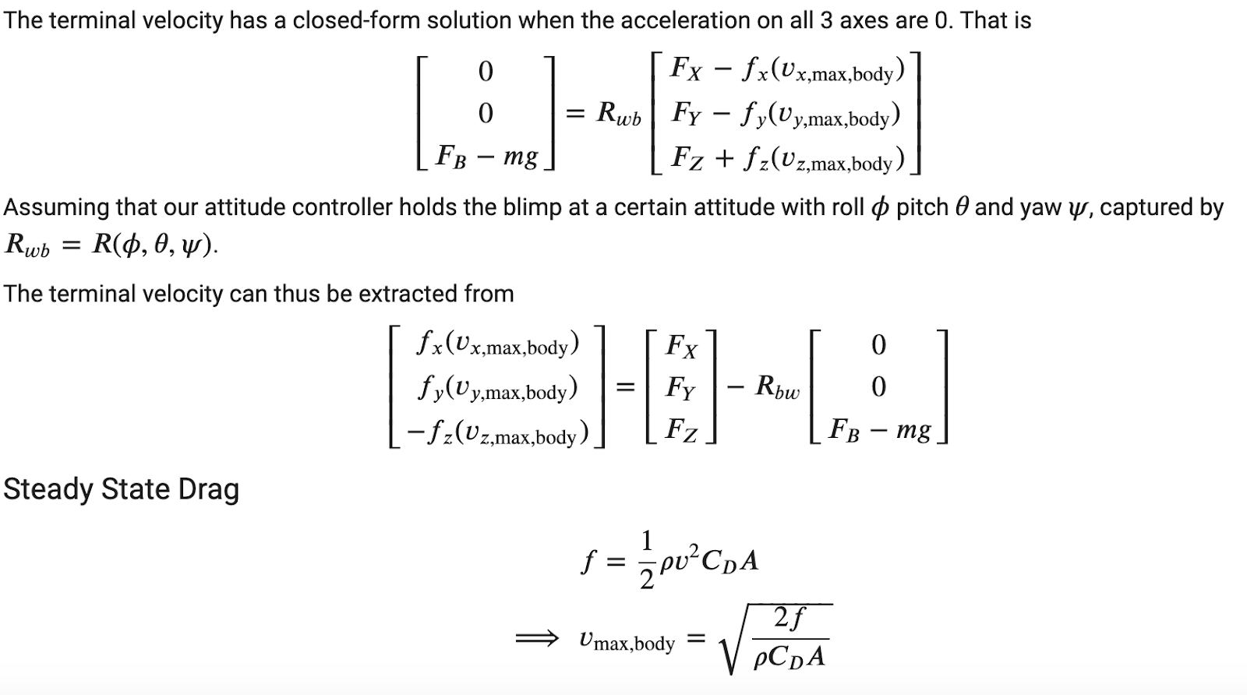
Dynamics - Closed-form Solution
J. B. Mueller, M. A. Paluszek, and Y. Zhao, “Development of an Aerodynamic Model and Control Law Design for a High Altitude Airship,” Proceeding of the AIAA 3rd Unmanned Unlimited Technical Conference, Workshop, and Exhibit, Chicago, IL, September 2004.

Slide 18
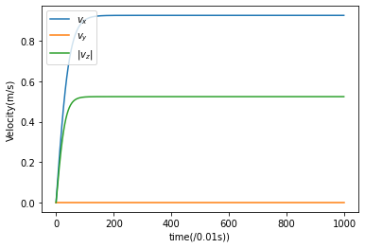
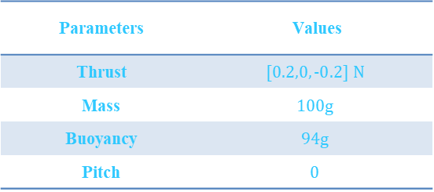
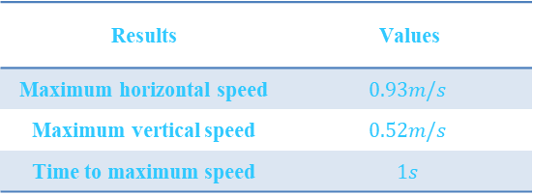
Simulations and Result Discussion
Parameters | Values
Thrust | $$[0.2,0,−0.2] N$$
Mass | $$100g$$
Buoyancy | $$94g$$
Pitch | $$0$$
Reality
✅ cross-checked with actual blimp performance
Sim
Setting
Results
Results | Values
Maximum horizontal speed | $$0.93m/s$$
Maximum vertical speed | $$0.52m/s$$
Time to maximum speed | $$1s$$
Fig.

Slide 19
IROS
03
Validation process
Come up with the validation process that could help validate the whole system and verify our system through experiments.
01
Consider more parameters in the design parameter space
Control surface, mechanical fin, weight distribution, power consumption
02
Increase the complexity of our evaluation system
Future work
Consider air friction and added mass into our system

Slide 20

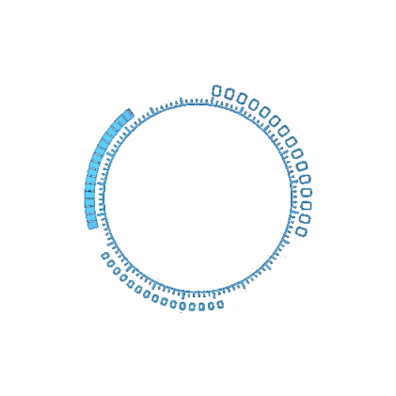

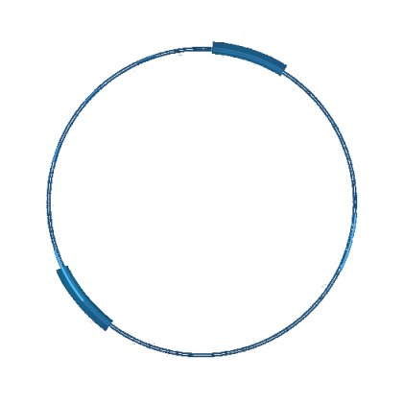
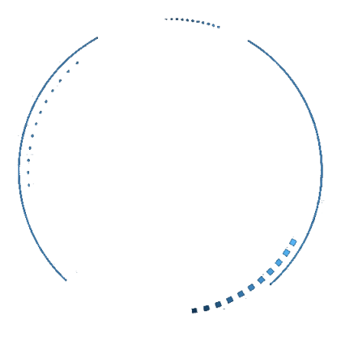
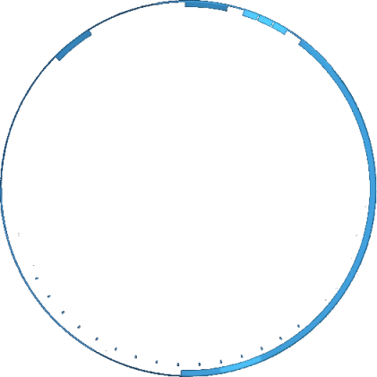

Thanks for your listening
Q&A?

